Slide 1
Digital Literacy

Slide 2
Introduction to Digital Literacy
Digital literacy is the ability to use, understand, and navigate digital technologies effectively.
Digital literacy encompasses key skills like critical thinking, online safety awareness, and the ability to find, evaluate, and communicate information in the digital world.
These skills are essential for success in today's interconnected society.

Slide 3
Core Components of Digital Literacy
Information Literacy
Media Literacy
Digital Communication
Online Safety
Critical Thinking
Technical Skills
Digital Ethics
Online Privacy

Slide 4
Digital Citizenship
Digital citizenship refers to the responsible and ethical use of technology in our online and offline lives.
Being a good digital citizen requires understanding and practicing appropriate behavior in the digital world.
  This includes resonsible social media use and online communication.
A violation of good digital citizenship is known as digital misconduct.
Cyberbullying, sharing misinformation, privacy violations, and online harassment are common example of poor digital citizenship practices.

Slide 5
Digital Identity and Social Media
Your digital identity is shared by every action you take online, including posts, comments, likes, and shares on social media platforms.
Most social media platforms require users to agree to terms of service that promote responsible online behavior and protect user privacy.

Slide 6
ONline Privacy Best Practices
The photographer owns the copyright if:
  Photographer was taking photos in a public place
  Photographer had permission from the property owner
Do people in a photo have any rights?
  Being photographed without your consent generally falls under the realm of privacy.
  If a photographer includes you in a photo that he intends to sell for publication, you’ll be asked to sign a model release.
    Model release - grants the photographer the right to use an image of the model (or subject of the photo) commercially.

Slide 7
How do you know if a photo on the Internet is copyrighted?
Usually information is attached to a photo to indicate it’s copyrighted, in the public domain, or that all rights are reserved.
  If there’s no information attached, the safest course of action is to assume that the photo is protected by copyright and you’d need permission to use the photo.
Many websites that contain copyrighted material also delineates the terms of use for downloading material from the site.
  Read the terms of use before using any copyrighted material on the site.

Slide 8
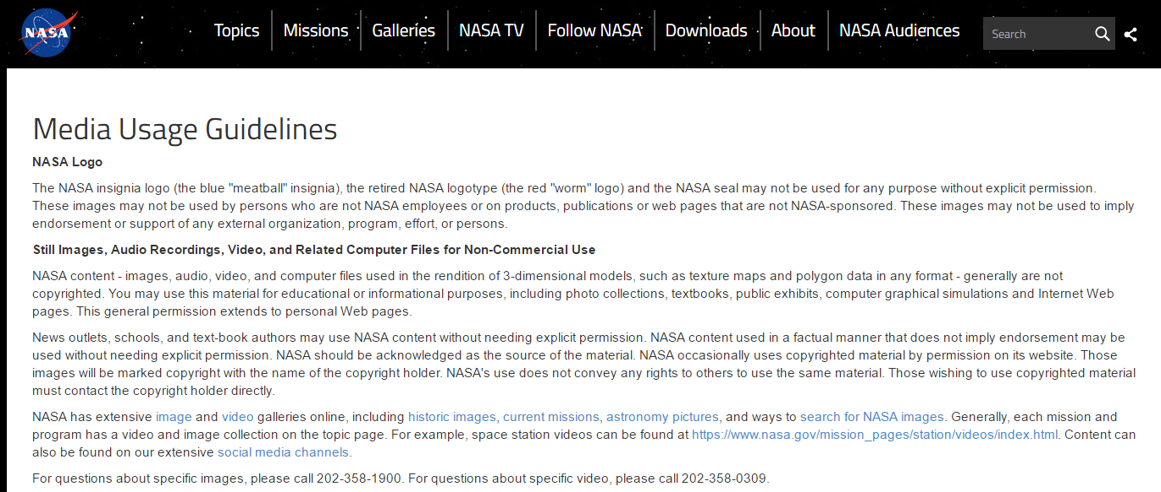
Terms of Use from Nasa.gov

Slide 9


Citing an Image

